Slide 1


Object Sorting Industrial Robotic Arm Based on Color using Arduino & MATLAB Computer Vision
Group No: 03
1706083 (Hemel Barua)
1706087 (Tushar Talukder Showrav)
1706094 (Sajib Bain)
1706096 (Md. Asiqur Rahman Santo)

Slide 2
Problem Statement
Manual sorting takes a long time when working with a large number of objects, and efficiency and precision will suffer as a result .
This project is proposed to separate the objects from a set according to their color.
Designing and implementation of synchronized robotic arm, which is used to perform all the basic activities like picking up objects and placing them.

Slide 3
Objectives
Object sorting based on color sensing.
Reduce human effort, labor and cost.
To implement this project in agricultural machineries like rice sorter, beans sorter, peanut sorter etc.
Increase efficiency in industrial product sorting.

Slide 4
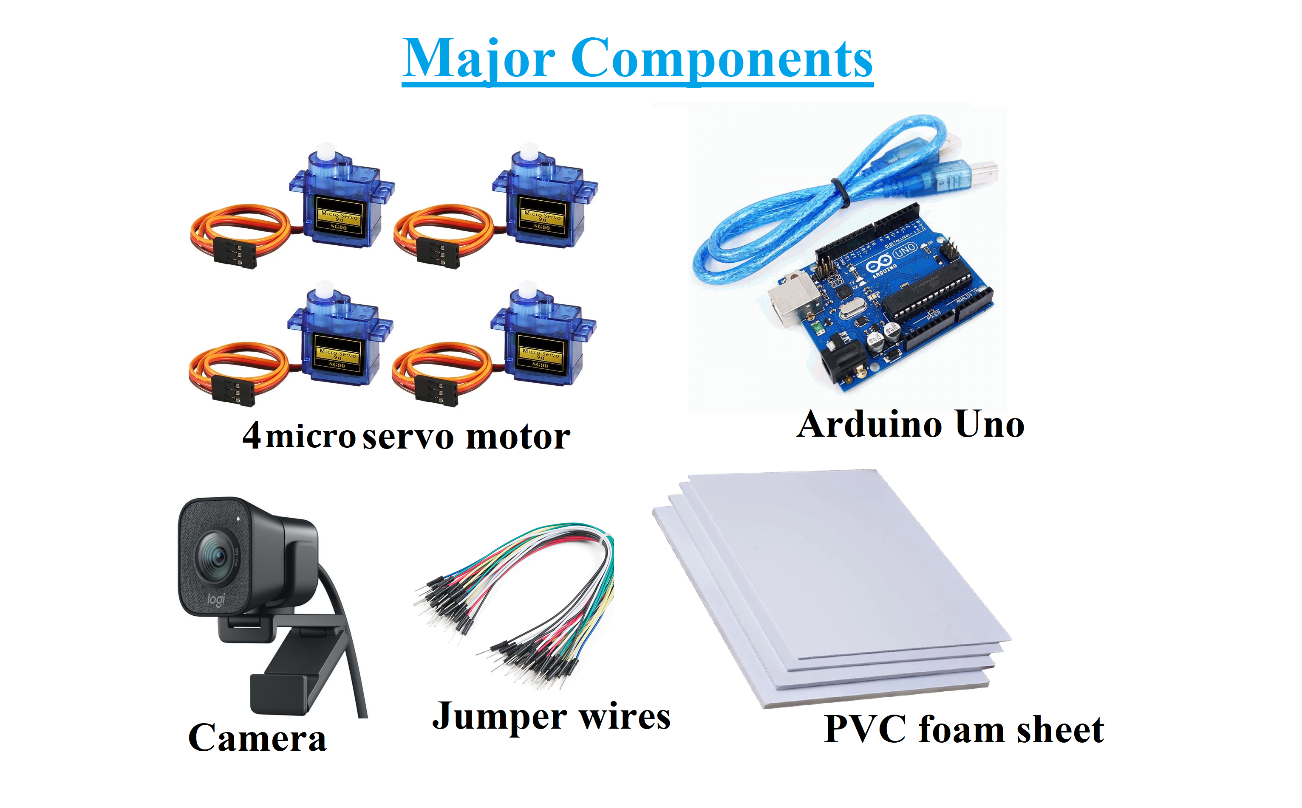

Slide 5
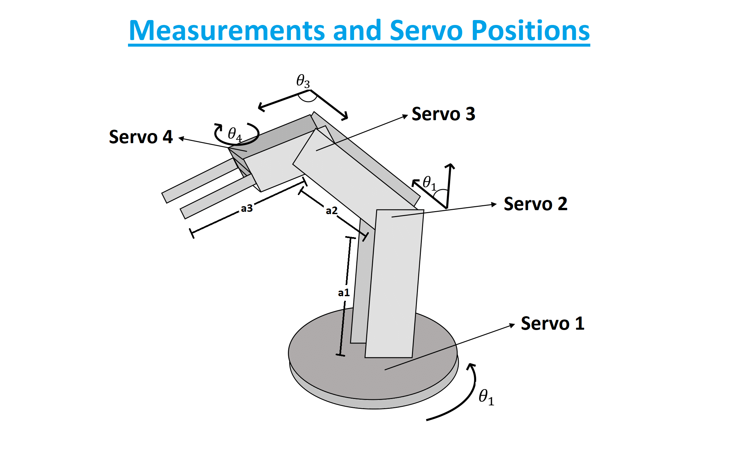

Slide 6
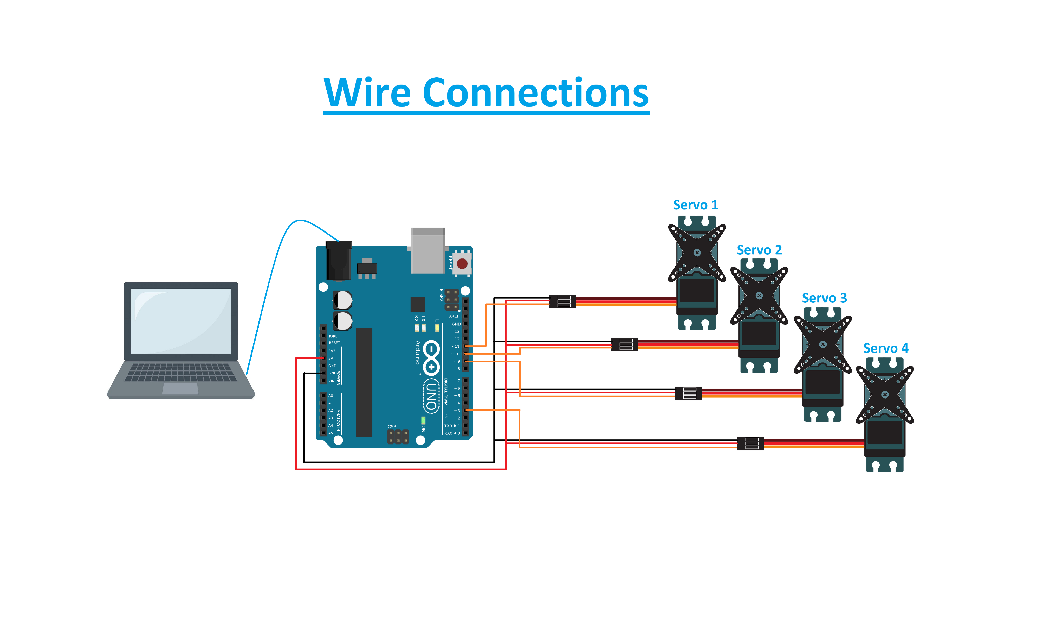

Slide 7
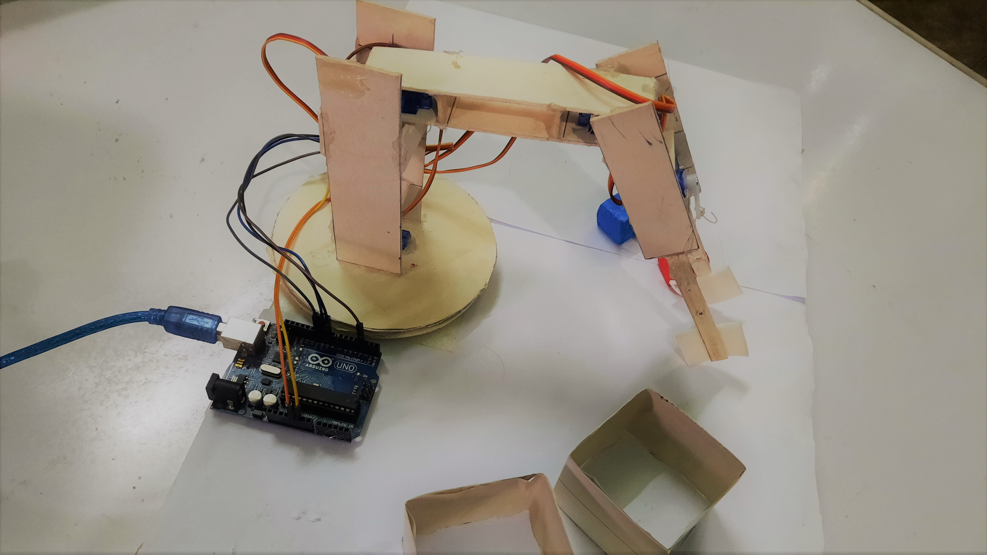
Robotic Arm Overview

Slide 8
Flowchart
If no object found
Code Initialization
Realtime Camera
Object sensing
Taking snapshot
Differentiate colors
Object detection
Initial position
Put it in the required box
Take the object
Calculate rotation angle of servos

Slide 9
Limitations
We built the body of the robotic arm from scratch using PVC foam board, and as we haven’t used any 3D printer, our robotic arm is not 100% precise.
We have used lower quality servo motors and still it costs a lot. And after testing our robotic arm for several times, the servos started to show unusual movements and gives 165/170 degree rotation instead of 180 degree rotation.
We have used smartphone camera for the realtime video input, but if there is used a good quality wired camera in a fixed position, then the precision will improve much more.

Slide 10
Sorting based on complex colors
Sorting based on size of the objects
Using deep learning techniques to use this robotic hand in agriculture, industries and other fields
Using higher torque stepper motor to lift more weighted objects and moving the arm more precisely
Using a good camera for increasing the precision much more.
Future Improvements

Slide 11
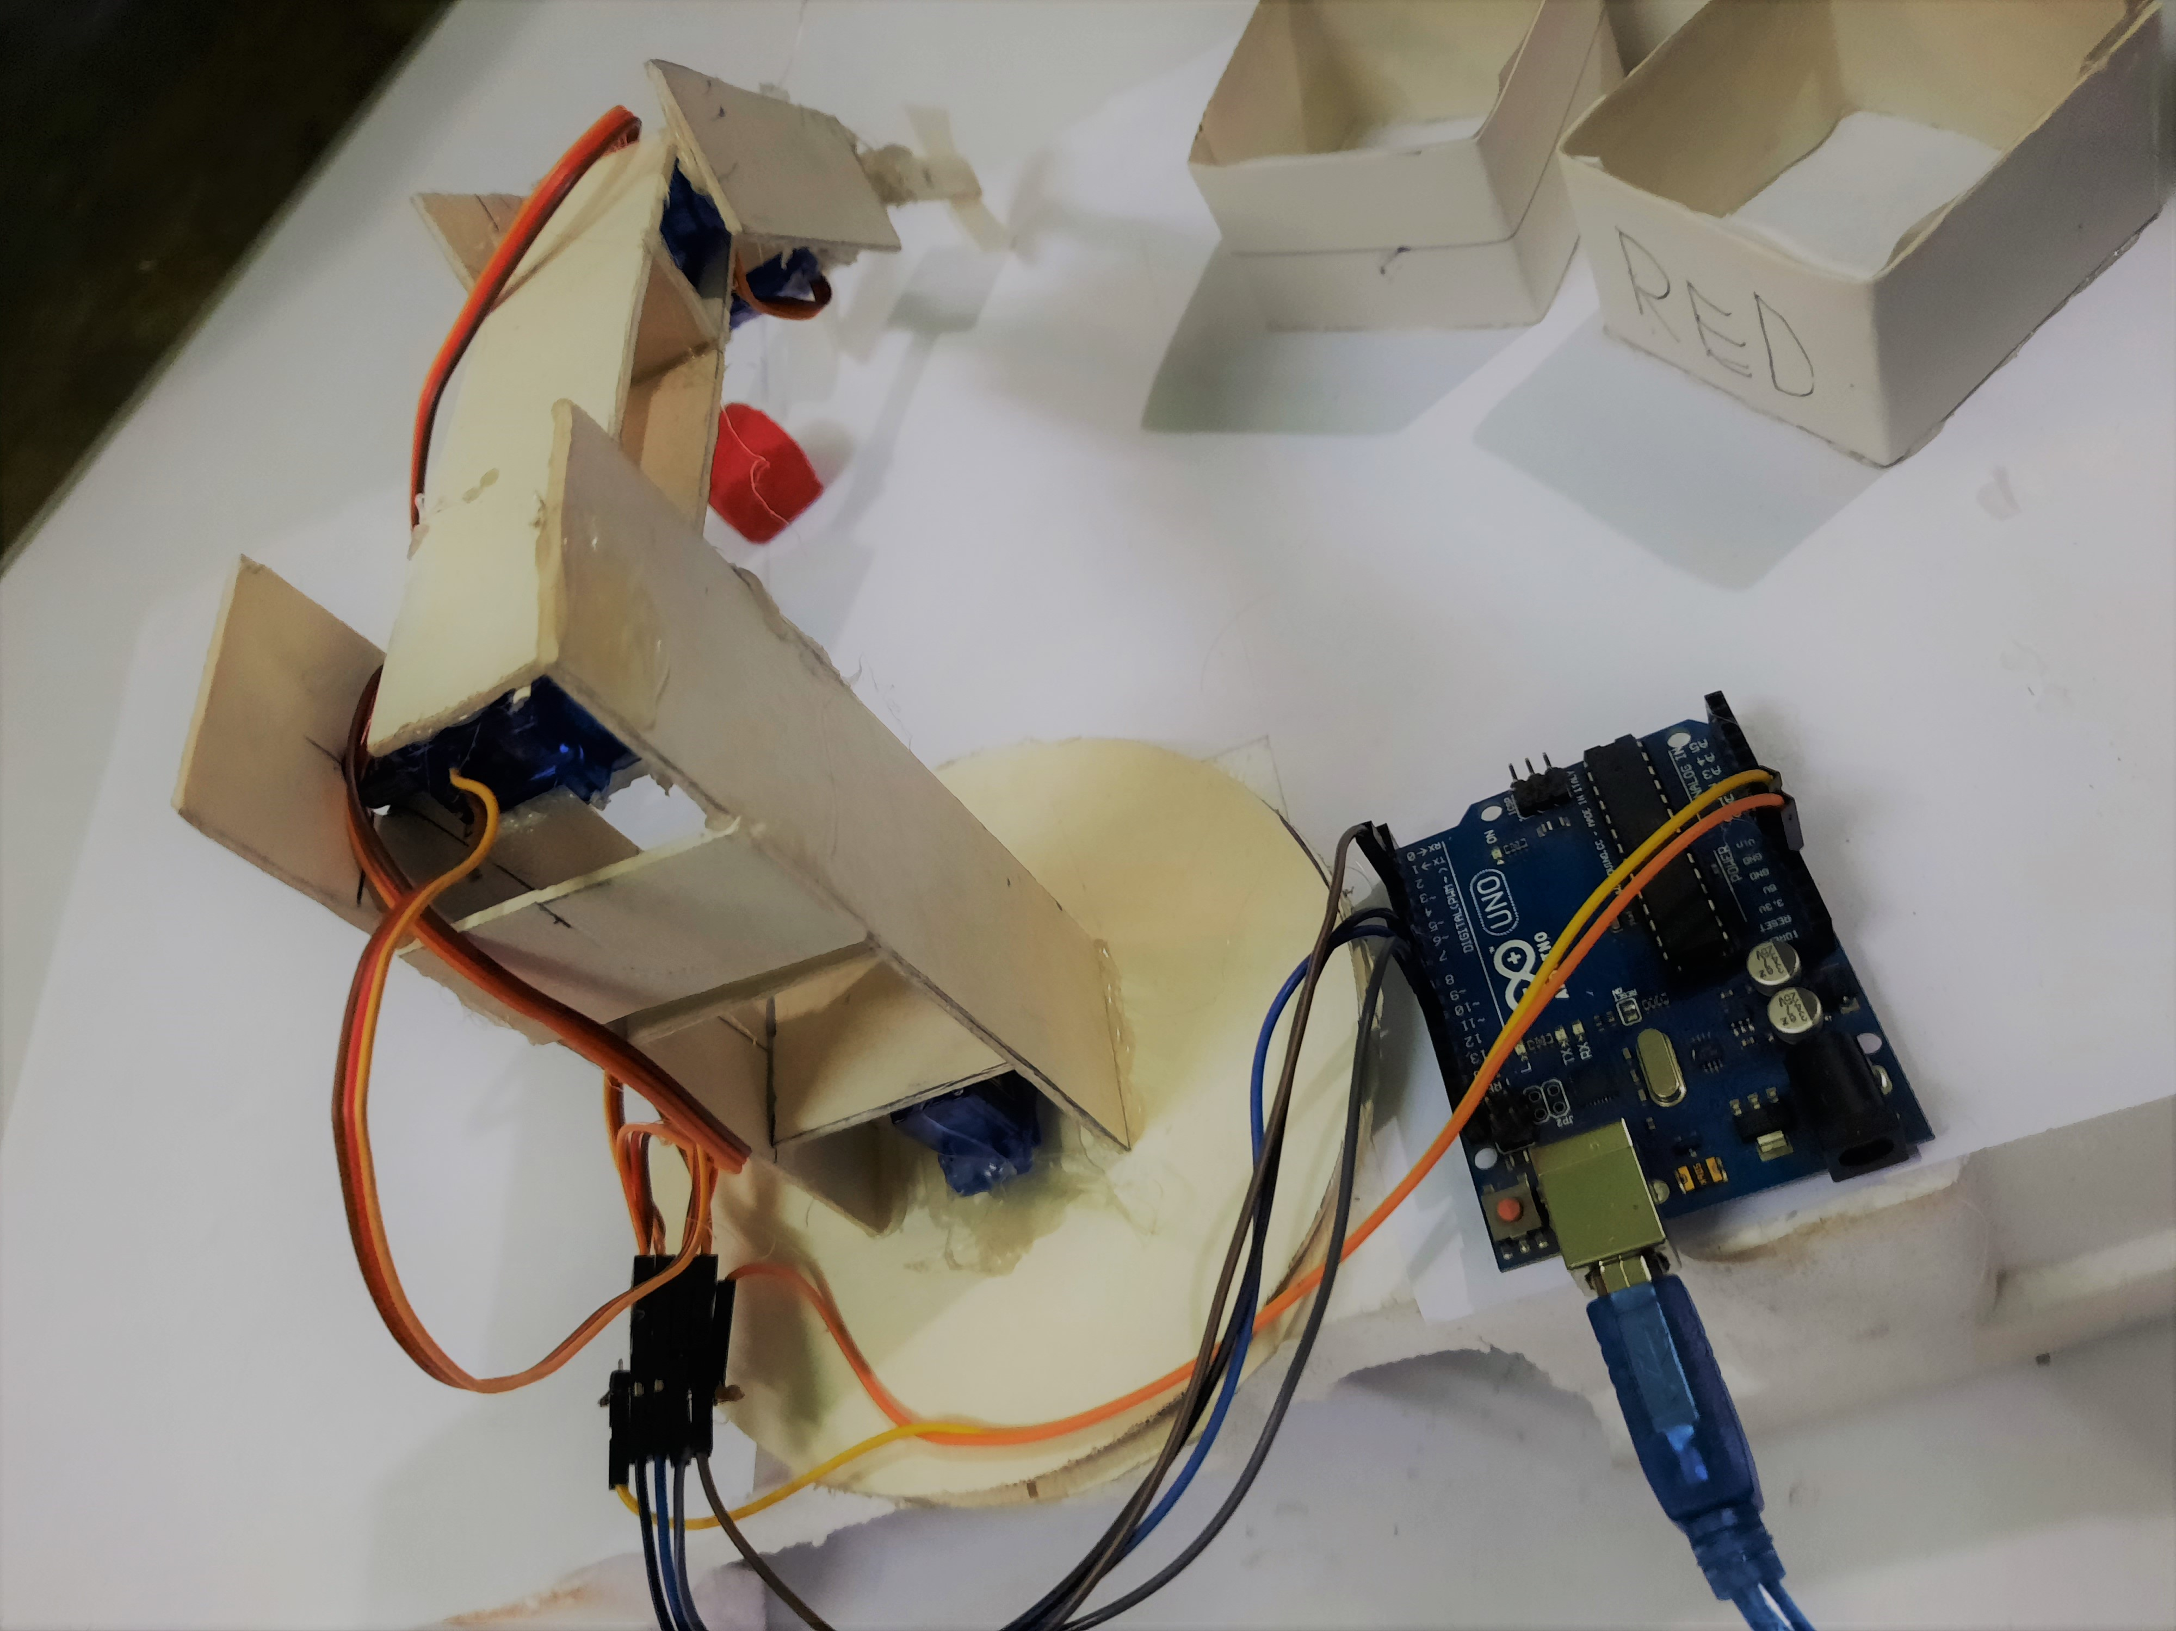
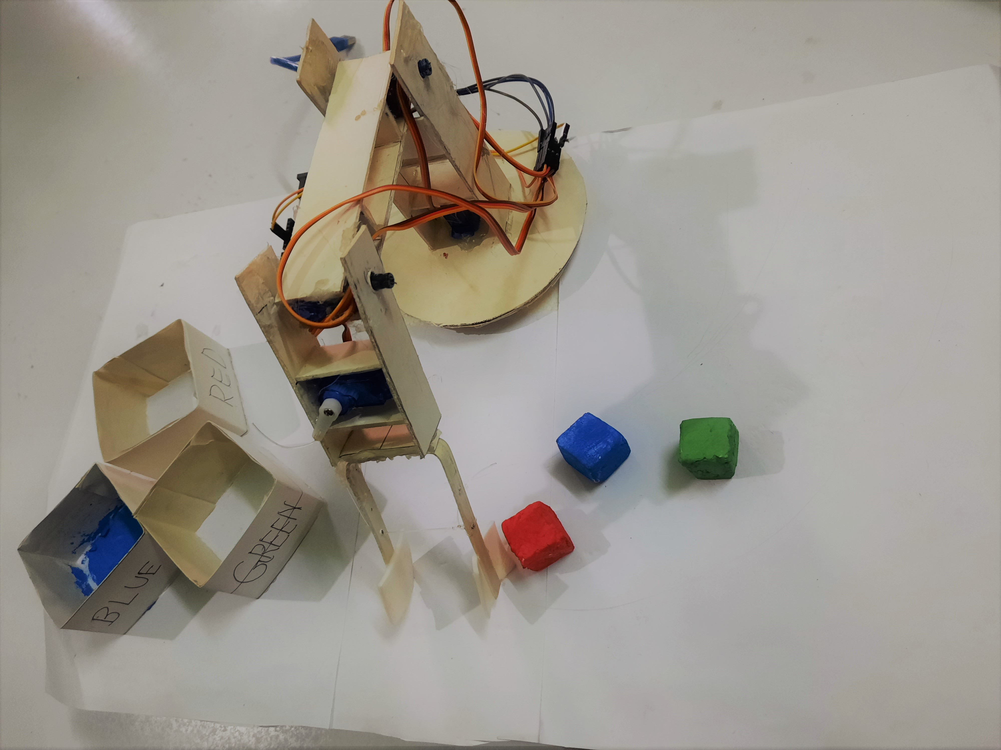
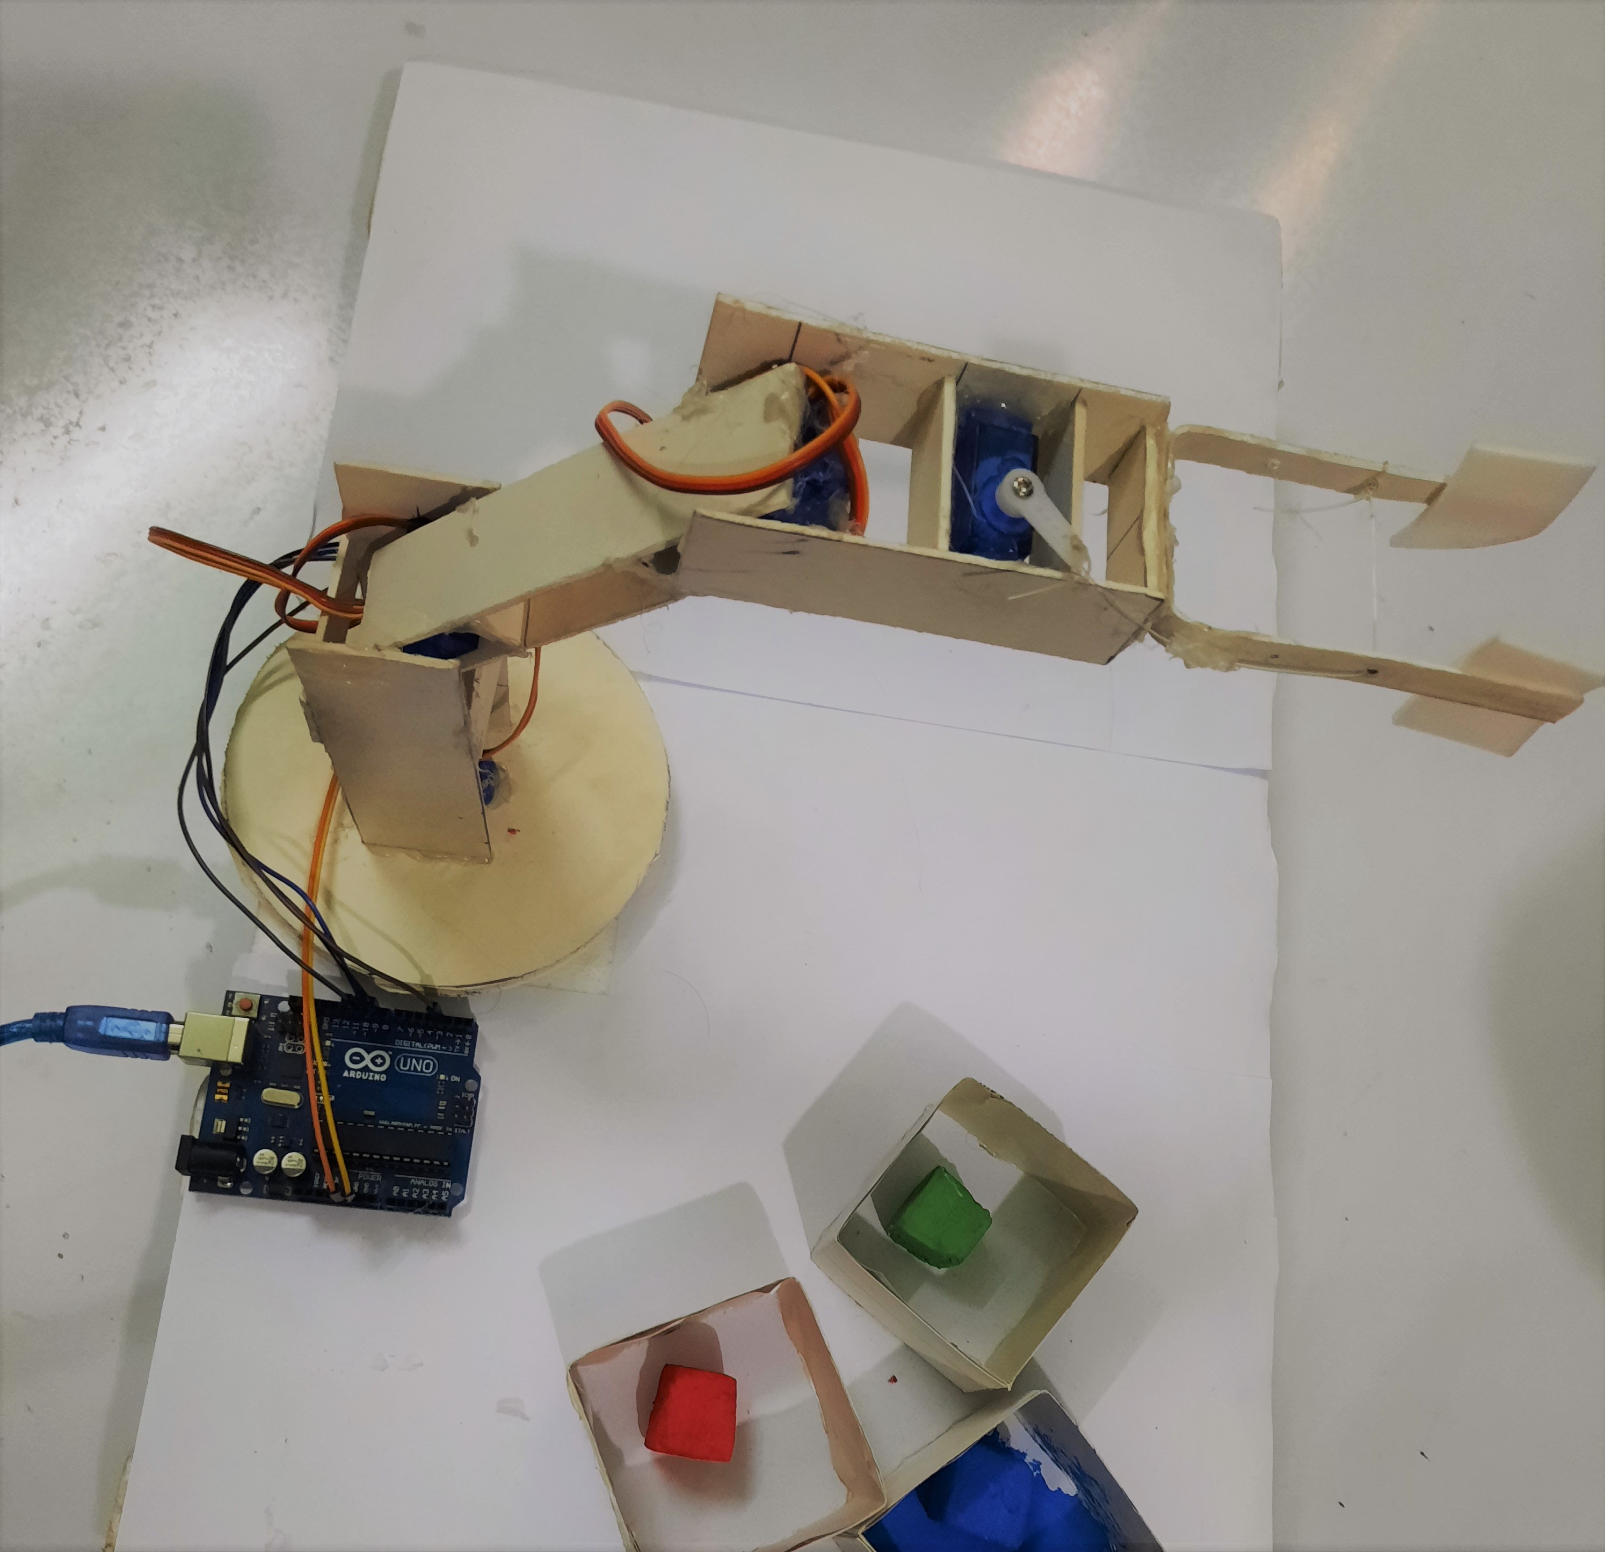
Different Views of The Robotic Arm

Slide 12

If you have any queries, please feel free to ask.

